Slide 1


UUI
GENERAL DYNAMICS
Electric Boat
Quality Data Analytics Team (DAT) Present and Future State
Larry Jacoinski
D424 Power BI Supervisor
ljacoins@gdeb.com
UUI

Slide 2
BLUF
UUI
The D424 Data Analytics Team (DAT) is seeking to expand its capabilities to support the M. Roberts organization.
The DATs growth strategy focus is on:
Enhancing data accessibility
Improving analytical depth
Proactively partnering with other departments, within the Quality organization, to drive actionable insights
The current organizational structure incorporates the DAT team as well as individual contributors within different facets of the organization creating metrics and reports. The target for the future state of reporting would be to have all Power BI contributors routed through the DAT team to ensure data accuracy and continuity.
UUI

Slide 3
Current State
UUI
L. Jacoinski Supervisor DAT
Groton Team
QP Team
Open Req
D. Foster, Qual Control Spec
QPS Coder
Data Modeler
P. Boursier, Qual Control Analyst Sr
QPS Coder
S. Molkenthin Data Modeler II
Data Modeler
M. Robinson, Data Analyst Spec Sr
Report Developer/ QPS Coder
Z. Weaver (onboarding) Data Analyst
Report Developer
S. Almeida Qual Control Spec
QPS Coder
R. Shaw, Qual Control Spec, Est start date 8/2/2026
QPS Coder
UUI

Slide 4
Team Functionality Coding/DSTs
UUI
Coding QPS/SAPIP Admin:
QPS:
Records are imported from multiple sources and prepped for entry into QPS.
Once all records are imported into QPS, the weighted labor numbers are formulated for people that perform the coding.
QPS coding involves
Metric Codes
Process Codes
Program Codes
Each code involves three levels; Category, Subcategory and 3rd level
SAPIP:
Creating checklists, making edits, and pulling data.
Coaching people on how to use it,
Problem solving, inquiries, requests, etc.
This database is used enterprise-wide; Groton, QP, Focus Factories, Kings Bay, Pearl Harbor,
Puget.
DST Support:
Creates data visuals that support the analysis of quality performance for DSTs.
Provide historic data for more robust analytics to include hull over hull comparison
Solicit feedback from downstream customers to continuously improve model capabilities.
Perform data analysis from available quality performance systems and communicate findings to the DSTs and supporting QAEs.
Provide initial problem identification and trending issues.
Summarize and visualize deficiency data for each DST.
Work with QAEs and Operations Analyst to provide supplemental analysis on identified problem areas which are determined most severe or most common.
UUI

Slide 5
QPS Data
UUI
Document types that go into QPS, and how they are received:
Audit (auto-email from Document Databank)
CAR (pulled from TSM)
DLS/TLS (emailed from Thomas Gendreau)
SAFE (emailed from Groton Safety)
SURV (pulled from SAPIP and NDT Surv from Janis)
RDR (pulled from the RDR database)
TIR/SFDR (pulled from 7G)
DL/DR (pulled form SPARS)
CRIT and EXT Audit need to be entered manually
All document types need to be groomed before being imported into QPS. Grooming includes adjusting project IDs, moving data to required columns, checking for character limitations, column format, removing erroneous input, etc.
UUI
Notes:
There are 47 different criteria fields to filter from when making data requests

Slide 6
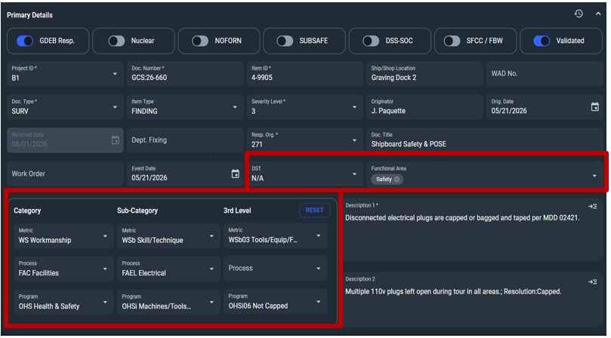
QPS Interface
UUI
UUI
Notes:
Sections outlined in Red are blank and must be populated by Coding team

Slide 7
Team Functionality Power BI
UUI
Data Modeler Role:
Design and build the data model: Create the blueprint of the data by defining tables, relationships, and hierarchies.
Establish relationships: Connect tables from different data sources, ensuring proper relationships are created so the data can be analyzed together.
Create calculations: Develop measures and calculated columns using DAX to meet specific business requirements.
Implement star schema: Structure the data using a star schema, which involves connecting dimension tables (like customers, products, and dates) to fact tables (like sales and transactions).
Improve performance: Optimize the model to ensure fast report load times and efficient data retrieval.
Maintain data integrity: Ensure data accuracy and consistency, creating a single source of truth that decision-makers can trust.
Collaborate with other roles: Work closely with data engineers to get clean data and with business users to understand data needs.
Data Analyst/Report Developer Role:
Requirements gathering: Work with stakeholders to understand their data needs and translate them into technical specifications.
Report and dashboard development: Design and develop interactive and visually appealing reports and dashboards using Power BI.
Performance optimization: Ensure reports and dashboards are performant and efficient.
Data accuracy and governance: Ensure data accuracy, security, and compliance within the reports.
Insight generation: Analyze the data to uncover trends and provide actionable insights to business teams.
UUI
Notes:
A basic analogy would be: Think of baking, the data modeler puts all of the ingrdents together and puts the cake in the oven. The report developer takes the cake out and decorates it.

Slide 8
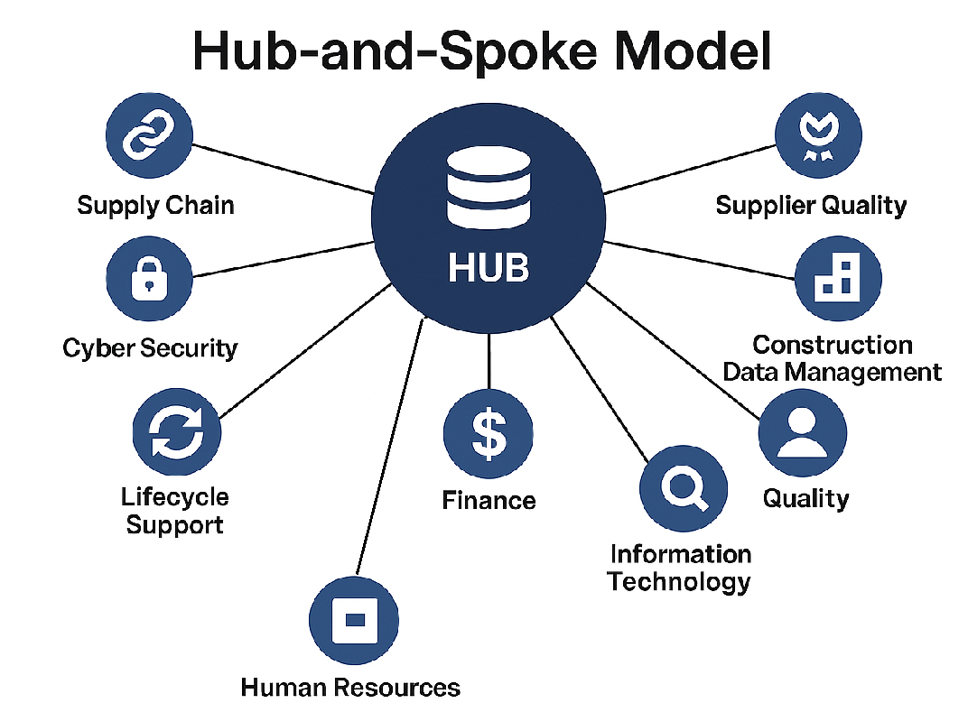
Hub and Spoke Model
UUI
UUI

Slide 9
M. Roberts Team BI Status
UUI
Director | Director Dept | Manager | Manager Dept | Report Dev Team Dept | Report Development | Bi Spoke
Adam Sederholt | 323 | Armand Allen | 326 | 324 | Liz Ryan's Team | Supplier Quality
Adam Sederholt | 323 | Jason Kennedy | 323 | 324 | Liz Ryan's Team | Supplier Quality
Adam Sederholt | 323 | JoAnne Russo | 324 | 324 | Liz Ryan's Team | Supplier Quality
Adam Sederholt | 323 | Joshua Chouinard | 324 | 324 | Liz Ryan's Team | Supplier Quality
Adam Sederholt | 323 | Thomas Belchik | 325 | 324 | Liz Ryan's Team | Supplier Quality
John Kimball | 938 | Apolonio Montejano | 938 | 938 | Quality Spoke Team, D938 RD's: T. Gordon, G. Cooke, H. Cook, L. Brennan | Quality
John Kimball | 938 | Douglas Finegan | 936 | 936 | Quality Spoke Team, D938 RD's: T. Gordon, G. Cooke, H. Cook, L. Brennan | Quality
John Kimball | 938 | Fredrick Barth | 939 | 939 | Quality Spoke Team, D938 RD's: T. Gordon, G. Cooke, H. Cook, L. Brennan | Quality
John Kimball | 938 | Mark Glennon | 937 | 937 | Quality Spoke Team, D938 RD's: T. Gordon, G. Cooke, H. Cook, L. Brennan | Quality
Sean Reith | 320 | Benjamin Vreeland | 322 | 424 | Quality Spoke Team, D322 RD's: J. Westervelt, J. Varkey, A. Dudau | Quality
Sean Reith | 320 | Kerri-Anne Nunn | 322 | 424 | Quality Spoke Team, D322 RD's: J. Westervelt, J. Varkey, A. Dudau | Quality
Sean Reith | 320 | Thomas Yeo | 321 | 424 | Quality Spoke Team, D322 RD's: J. Westervelt, J. Varkey, A. Dudau | Quality
Sean Reith | 320 | Timothy Cochran | 321 | 424 | Quality Spoke Team, D322 RD's: J. Westervelt, J. Varkey, A. Dudau | Quality
Jeffery Hooper | 420 | Ervin Doubleday | 423 | 424 | Quality Spoke Team | Quality
Jeffery Hooper | 420 | German Felix | 421 | 424 | Quality Spoke Team | Quality
Jeffery Hooper | 420 | Robert Rasmussen | 424 | 424 | Quality Spoke Team | Quality
Kirk Scheel | 341 | John Tuneski | 343 | 424 | Quality Spoke Team | Quality
Kirk Scheel | 341 | Patrick Gouveia | 341 | 424 | Quality Spoke Team | Quality
Kirk Scheel | 341 | Raymond Filosa | 341 | 424 | Quality Spoke Team | Quality
Kirk Scheel | 341 | Robert Niles | 341 | 424 | Quality Spoke Team | Quality
Kirk Scheel | 341 | Steven Mayott | 342 | 424 | Quality Spoke Team | Quality
Kirk Scheel | 341 | Vincent Mangino | 341 | 424 | Quality Spoke Team | Quality
Jeffery Johnson | 438 | Gregory Wong | 438 | 438 | Dylan Austin-Mathley, with support from Quality Spoke Team | Quality
Jeffery Johnson | 438 | Kristen Woodka | 438 | 438 | Dylan Austin-Mathley, with support from Quality Spoke Team | Quality
Jeffery Johnson | 438 | Nathan Hall | 438 | 438 | Dylan Austin-Mathley, with support from Quality Spoke Team | Quality
Jeffery Johnson | 438 | Robert Rommel | 438 | 438 | Dylan Austin-Mathley, with support from Quality Spoke Team | Quality
Daniel Vieira | 645 | Boyd Weese | 645 | 355 | Allison Staniec's Team | Planning
Daniel Vieira | 645 | Marie Martin | 503 | 355 | Allison Staniec's Team | Planning
Daniel Vieira | 645 | Matthew Crimmins | 975 | 355 | Allison Staniec's Team | Planning
Daniel Vieira | 645 | Peter Raffo | 506 | 355 | Allison Staniec's Team | Planning
UUI

Slide 10
Future State of the D424 DAT (Target)
UUI
D424 DAT Supervisor
SME Report Developers
SME Report Developers
SME Report Developers
Radiological Controls
(Johnson) D438
Quality Assurance
(Reith) D320
Quality Assurance Quonset Point
(Kimball) D938
UUI
Notes:
The SME Report developers can either be a dotted line if they already exist within the target organization or a solid line if they will be a new head.

Slide 11
Next Steps
UUI
Open req for Data Analyst/Report Developer (2025-16363) – Offer accepted, currently onboarding
Open req for Quality Control Analyst, offer accepted start date 8/2/2026
Meet with department managers to attain stakeholder buy in for identifying Power BI report developer within their organization that can support 424 future state DAT - (Complete)
UUI

